Slide 1


Window Functions
Naved Akhtar

Slide 2
Syntax
window_function(arg1, arg2,..) OVER ( [PARTITION BY partition_expression] [ORDER BY sort_expression [ASC | DESC] [NULLS {FIRST | LAST }])

Slide 3
PARTITION BY CLAUSE
The PARTITION BY clause divides rows into multiple groups or partitions to which the window function is applied.
The PARTITION BY clause is optional. If you skip the PARTITION BY clause, the window function will treat the whole result set as a single partition.

Slide 4
ORDER BY CLAUSE
The ORDER BY clause specifies the order of rows in each partition to which the window function is applied.
The ORDER BY clause uses the NULLS FIRST or NULLS LAST option to specify whether nullable values should be first or last in the result set. The default is NULLS LAST option.

Slide 5
Most Used Window Functions
Name | Description
ROW_NUMBER | Number the current row within its partition starting from 1.
RANK | Rank the current row within its partition with gaps.
DENSE_RANK | Rank the current row within its partition without gaps.
FIRST_VALUE | Return a value evaluated against the first row within its partition.
LAST_VALUE | Return a value evaluated against the last row within its partition.
LAG | Return a value evaluated at the row that is at a specified physical offset row before the current row within the partition.
LEAD | Return a value evaluated at the row that is offset rows after the current row within the partition.

Slide 6
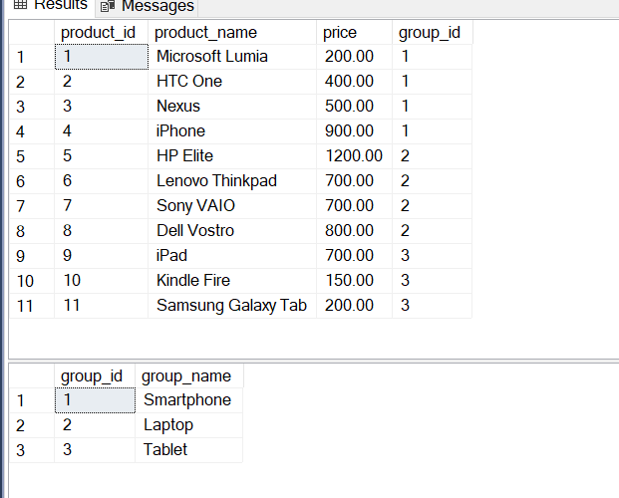
Sample products and product_groups tables

Slide 7
Row Number
The ROW_NUMBER() function assigns a sequential number to each row in each partition. See the following query
SELECT
product_name,
group_name,
price,
ROW_NUMBER () OVER (
PARTITION BY group_name
ORDER BY
price
) rn
FROM
products p
INNER JOIN product_groups pg
ON p.group_id=pg.group_id;

Slide 8
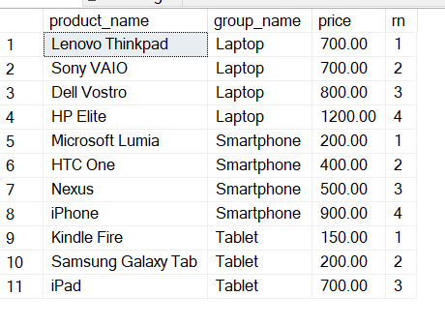
Row Number Output

Slide 9
RANK
The RANK() function assigns ranking within an ordered partition. If rows have the same values, the RANK() function assigns the same rank, with the next ranking(s) skipped.

Slide 10
DENSE_RANK
Similar to the RANK() function, the DENSE_RANK() function assigns a rank to each row within an ordered partition, but the ranks have no gap. In other words, the same ranks are assigned to multiple rows and no ranks are skipped.

Slide 11
FIRST_VALUE, LAST_VALUE
The FIRST_VALUE() function returns a value evaluated against the first row within its partition, whereas the LAST_VALUE() function returns a value evaluated against the last row in its partition. SELECT
product_name,
group_name,
price,
FIRST_VALUE (price) OVER (
PARTITION BY group_name
ORDER BY
price
) AS lowest_price_per_group
FROM
products p
INNER JOIN product_groups pg
ON p.group_id=pg.group_id;

Slide 12
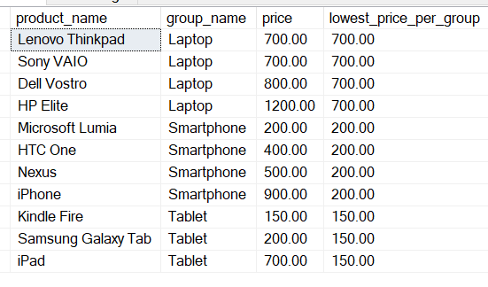
FIRST_VALUE OUTPUT

Slide 13
LEAD, LAG
The LAG() function has the ability to access data from the previous row, while the LEAD() function can access data from the next row.
Both LAG() and LEAD() functions have the same syntax as follows:
LAG (expression [,offset] [,default]) over_clause;
LEAD (expression [,offset] [,default]) over_clause;

Slide 14
LEAD, LAG CONTD.
SELECT
product_name,
group_name,
price,
LAG (price, 1) OVER (PARTITION BY group_name ORDER BY price) AS prev_price,
price - LAG (price, 1) OVER (PARTITION BY group_name ORDER BY price) AS cur_prev_diff
FROM
products p
INNER JOIN product_groups pg
ON p.group_id=pg.group_id;

Slide 15
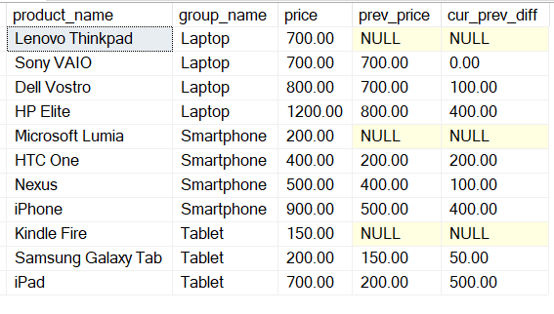
LEAD,LAG Output

Slide 16
Window Frame Clauses
ROWS BETWEEN
This clause defines the window frame based on the number of rows before and after the current row.
Example : ROWS BETWEEN 1 PRECEDING AND 1 FOLLOWING
RANGE BETWEEN
This clause defines the window frame based on the values of the rows before and after the current row, rather than the number of rows.
Example :RANGE BETWEEN INTERVAL '1' DAY PRECEDING AND INTERVAL '1' DAY

Slide 17
Window Frame Clauses (Absolute Boundaries)
UNBOUNDED PRECEEDING
Starting point of a window frame
Indicates that the window frame includes all rows from the partition's first row up to the current row.
UNBOUNDED FOLLOWING
Ending point of a window frame
Indicates that the window frame includes all rows from the current row upto the partition's last row
CURRENT ROW
This keyword specifies the current row within the window frame

Slide 18
Window Frame Clauses (Absolute Boundaries) Contd.
SELECT
product_name,
group_name,
price,
LAST_VALUE (price) OVER (
PARTITION BY group_name
ORDER BY
price RANGE BETWEEN UNBOUNDED PRECEDING
AND UNBOUNDED FOLLOWING
) AS highest_price_per_group
FROM
products p
INNER JOIN product_groups pg ON p.group_id=pg.group_id;

Slide 19
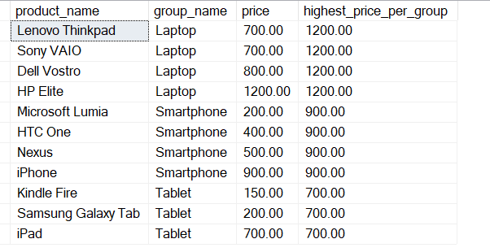
Window Frame Clauses (Absolute Boundaries) Output

Slide 20
Thanks !
Any Questions?

